Slide 1
INAPPROPRIATE EXPRESSIONS RECOGNITION USING BOOTSTRAPPING AS SEMI-SUPERVISED LEARNING
BSCS 4-2
MEMBERS:
DAPITAN, JOSHUA S.
LASALA, ANJANETTE R.

Slide 2
introduction
Inappropriate expressions becomes very interesting in the field of natural language processing.
Inappropriate expressions mostly causes problems in literary management like cyber bullying and exposure of children to other textual data.
The problems that need to be solved are the following:
Inherent ambiguity of the language
Accuracy of the system

Slide 3
Statement of the problem
The study aims to design, develop and evaluate the system which will help to recognize Inappropriate Expressions from a document. The people who are in knowledgeable in English language are the respondents in this study. In addition to this, the researchers aim to seek answer to this problem:
What is the performance analysis of the model in terms of:
1. Recognition of Inappropriate expressions. (Accuracy of the Model)
2. Recognition of Appropriate expressions. (Specificity of the Model)

Slide 4
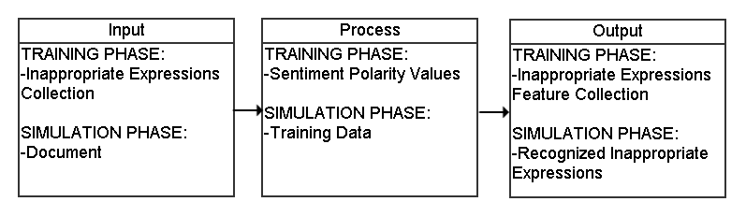
Conceptual framework of the system

Slide 5
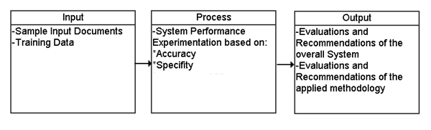
Conceptual framework of the study

Slide 6
Scope and limitations of the system
The system will be deployed as Java Application.
The system will accept an English comment as an input.
Underscores, slashes symbols, lexical distortions and multiple word idioms are to be avoided as an input.
The analysis will be based on the phrase level orientation based on the output of the n-gram model which is 2-5 gram N-Gram Model.

Slide 7
Scope and limitations of the study
The system will be evaluated by an expert, which is an English Teacher.
The inputs will be documents and text file.

Slide 8
System architecture
Learning Module for InappEx Recognition
Inappropriate Expressions Collection
Inappropriate Expression Feature Extractor
Collection of Inappropriate Expression Feature
Synset Resampler
Dictionary
Sentiment Corpus

Slide 10
Collection of Inappropriate Expression Feature
Learning Module for InappExpr Patterns
Inappropriate Expressions Candidation
N-Gram Generation
N-Gram Collection
Training Comment

Slide 12
A
N
A
L
Y
Z
E
R
F
O
R
I
N
A
P
P
R
O
P
R
I
A
T
E
E
X
P
R
S
P
Preprocessing
Input
Sentence Splitter
Inappropriate Expressions Candidation
N-Gram Collection
Tokenizer
N-Gram Parser
POS Tagger
Relational Inference Analyzer
Inappropriate Expressions in the Input
Stemmer
Entity Tagger

Slide 13
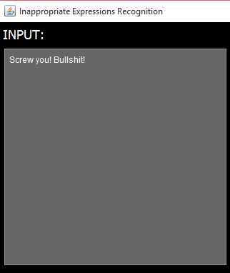

Slide 14
A
N
A
L
Y
Z
E
R
F
O
R
I
N
A
P
P
R
O
P
R
I
A
T
E
E
X
P
R
S
P
Preprocessing
Input
Sentence Splitter
Inappropriate Expressions Candidation
N-Gram Collection
Tokenizer
N-Gram Parser
POS Tagger
Relational Inference Analyzer
Inappropriate Expressions in the Input
Stemmer
Entity Tagger

Slide 15
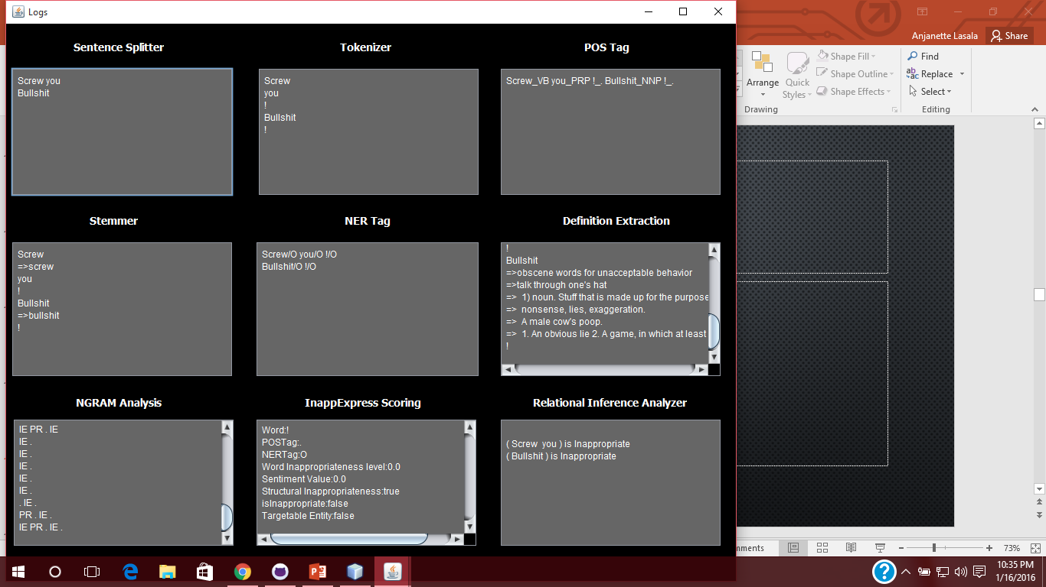

Slide 16
A
N
A
L
Y
Z
E
R
F
O
R
I
N
A
P
P
R
O
P
R
I
A
T
E
E
X
P
R
S
P
Preprocessing
Input
Sentence Splitter
Inappropriate Expressions Candidation
N-Gram Collection
Tokenizer
N-Gram Parser
POS Tagger
Relational Inference Analyzer
Inappropriate Expressions in the Input
Stemmer
Entity Tagger

Slide 18
A
N
A
L
Y
Z
E
R
F
O
R
I
N
A
P
P
R
O
P
R
I
A
T
E
E
X
P
R
S
P
Preprocessing
Input
Sentence Splitter
N-Gram Collection
Inappropriate Expressions Candidation
Tokenizer
N-Gram Parser
POS Tagger
Relational Inference Analyzer
Inappropriate Expressions in the Input
Stemmer
Entity Tagger

Slide 20
A
N
A
L
Y
Z
E
R
F
O
R
I
N
A
P
P
R
O
P
R
I
A
T
E
E
X
P
R
S
P
Preprocessing
Input
Sentence Splitter
Inappropriate Expressions Candidation
N-Gram Collection
Tokenizer
N-Gram Parser
POS Tagger
Relational Inference Analyzer
Inappropriate Expressions in the Input
Stemmer
Entity Tagger

Slide 22
A
N
A
L
Y
Z
E
R
F
O
R
I
N
A
P
P
R
O
P
R
I
A
T
E
E
X
P
R
S
P
Preprocessing
Input
Sentence Splitter
Inappropriate Expressions Candidation
N-Gram Collection
Tokenizer
N-Gram Parser
POS Tagger
Relational Inference Analyzer
Inappropriate Expressions in the Input
Stemmer
Entity Tagger

Slide 24
A
N
A
L
Y
Z
E
R
F
O
R
I
N
A
P
P
R
O
P
R
I
A
T
E
E
X
P
R
S
P
Preprocessing
Input
Sentence Splitter
Inappropriate Expressions Candidation
N-Gram Collection
Tokenizer
N-Gram Parser
POS Tagger
Relational Inference Analyzer
Inappropriate Expressions in the Input
Stemmer
Entity Tagger

Slide 25
A
N
A
L
Y
Z
E
R
F
O
R
I
N
A
P
P
R
O
P
R
I
A
T
E
E
X
P
R
S
P
Preprocessing
Input
Sentence Splitter
Inappropriate Expressions Candidation
N-Gram Collection
Tokenizer
N-Gram Parser
POS Tagger
Relational Inference Analyzer
Inappropriate Expressions in the Input
Stemmer
Entity Tagger

Slide 26
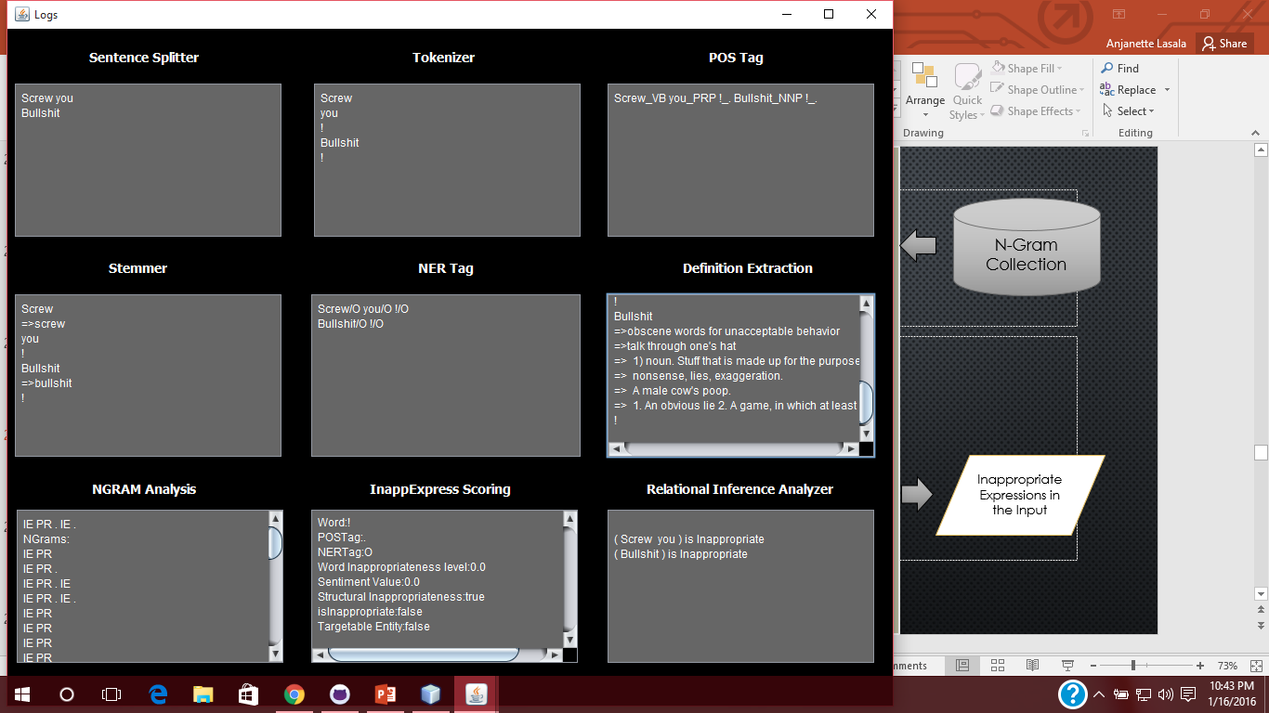

Slide 27
A
N
A
L
Y
Z
E
R
F
O
R
I
N
A
P
P
R
O
P
R
I
A
T
E
E
X
P
R
S
P
Preprocessing
Input
Sentence Splitter
Inappropriate Expressions Candidation
N-Gram Collection
Tokenizer
N-Gram Parser
POS Tagger
Relational Inference Analyzer
Inappropriate Expressions in the Input
Stemmer
Entity Tagger

Slide 29
A
N
A
L
Y
Z
E
R
F
O
R
I
N
A
P
P
R
O
P
R
I
A
T
E
E
X
P
R
S
P
Preprocessing
Input
Sentence Splitter
N-Gram Collection
Inappropriate Expressions Candidation
Tokenizer
N-Gram Parser
POS Tagger
Relational Inference Analyzer
Inappropriate Expressions in the Input
Stemmer
Entity Tagger

Slide 30
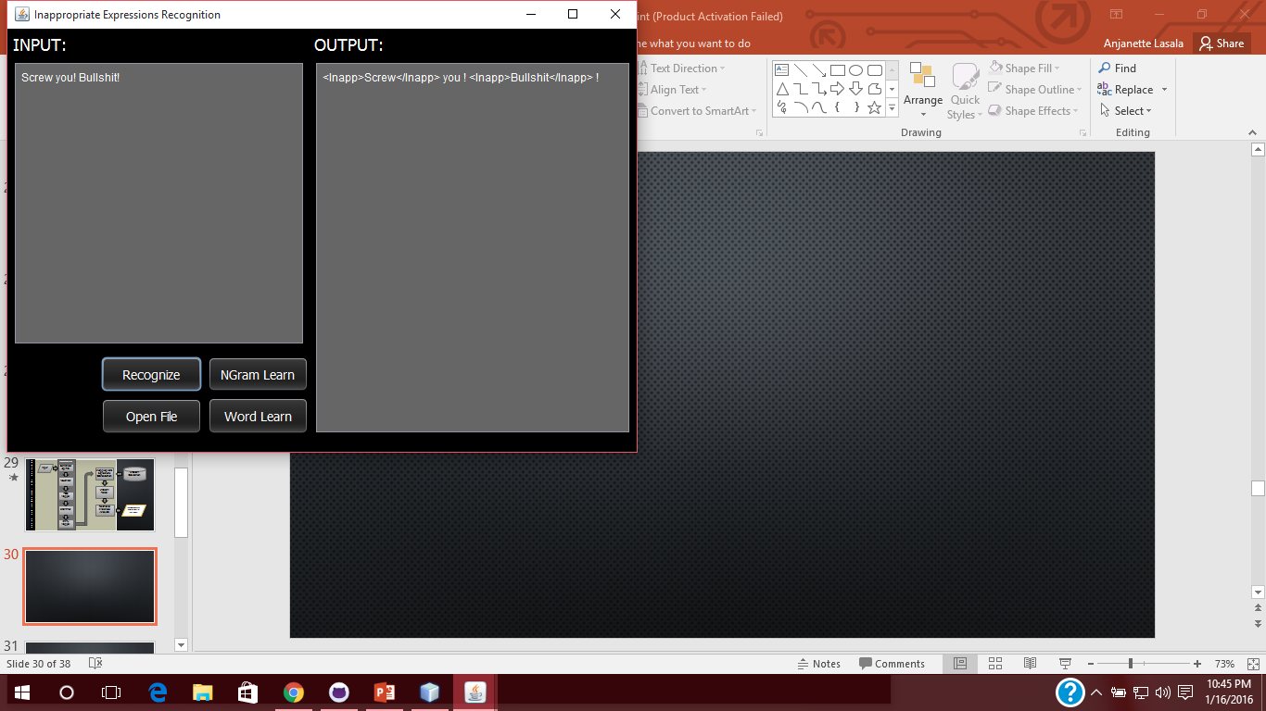

Slide 31
Relational Inference Analyzer
Expression Chains with Inappropriate Expressions
Bag of Words Model for Inappropriate Expressions
Hidden Markov Model for InappExprs referencing
Inappropriateness

Slide 33
Sample size
Sample size is an important concept in statistics and refers to the number of individual pieces of data collected. A statistic’s sample size is important in determining the accuracy and reliability of the system.
In contrast to other researches which is most likely used people as their population, this study focused on objects as its focus. These objects that were obtained from 9gag and YouTube comments were set to 400 due to unknown total population.

Slide 34
Experiment paper
Sentences | Tagged Tokens that is inappropriate
 | System | Expert
1
2
3
4
5
Experiment Paper I – Determining inappropriate expressions between system and expert.

Slide 35
Experiment Paper
Sentence | No. of Tokens | TP | FP | TN | FN
1
2
3
4
5
Total
Average
Experiment Paper II – Input Scoring.

Slide 36
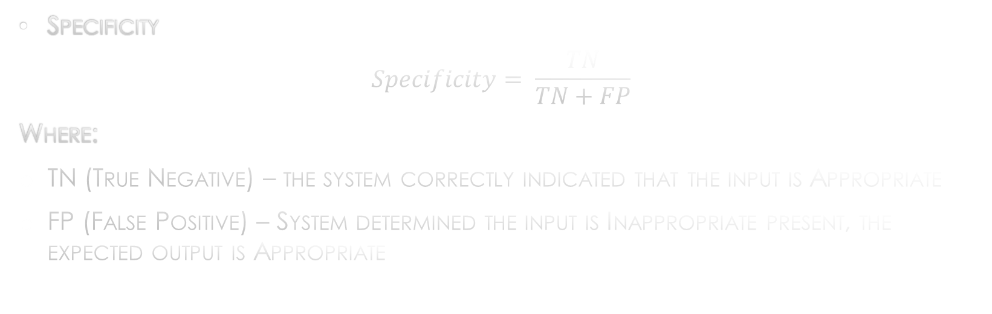
Statistical treatment
Specificity
$$Specificity= \frac{TN}{TN+FP}$$
Where:
TN (True Negative) – the system correctly indicated that the input is Appropriate
FP (False Positive) – System determined the input is Inappropriate present, the expected output is Appropriate

Slide 37
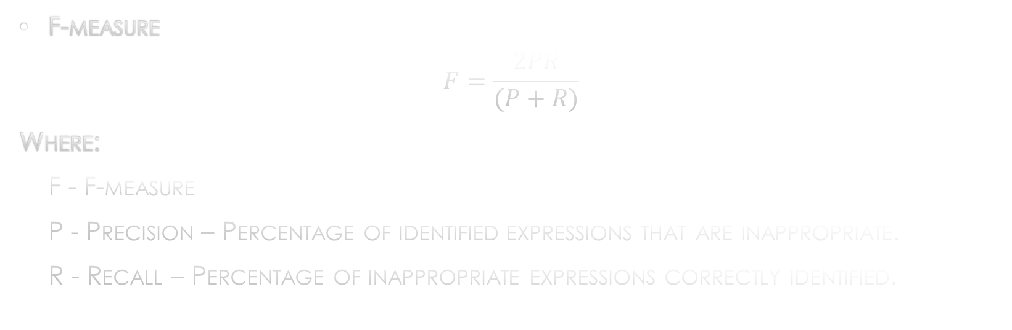
Statistical treatment
F-measure
$$F=\frac{2PR}{(P+R)}$$
Where:
F - F-measure
P - Precision – Percentage of identified expressions that are inappropriate.
R - Recall – Percentage of inappropriate expressions correctly identified.

Slide 38
end

